Slide 1
Expectation Maximization
Pattabiramann Balasubrahmaniam – 110097754
Gladson George – 110091793
Ajay Kanagarethinam Rajakumar – 110082468
Instructor:
Dr. Yasser Alginahi
November 3, 2023

Slide 2
Will I do good?
Determine my success rate
Look at the problem another way
Reviews!

Slide 3
A Real Life Problem
-The 3D Print

Slide 4
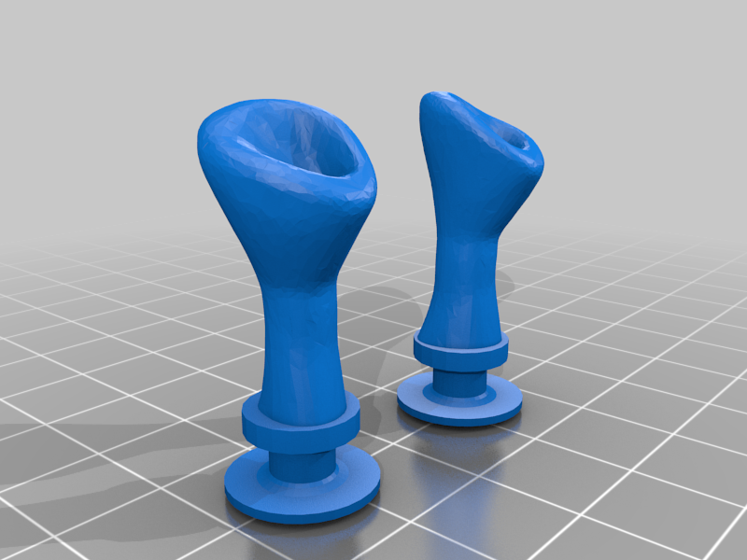

The Hunt for 3-D Printers
Send the model->Model is perfect->Happy customer
Source : https://tinyurl.com/mrmarxx5
Source : https://tinyurl.com/mrmarxx5

Slide 5
The Hunt for 3-D Printers
First Shop : Shop A = 188/200 Reviews
Second Shop : Shop B = 48/50 Reviews
Third Shop : Shop C = 10/10 Reviews
Shop A : 93% success
Shop B : 96% success
Shop C : 100% success

Slide 6
Let’s Apply!
Laplace adds : +2 to total, +1 to the success
Shop A : original = 188/200 = 94%
New : 189/202 = 93.5%
Shop B : original = 48/50 = 96%
New : 49/52 = 94.2%
Shop C : original = 10/10 = 100%
New : 11/12 = 91.6%

Slide 7

A Happy Customer!

Slide 8
Laplace’s Rule of Succession
In a given sample space and success rate,
Introduce one success and one failure observation in the sample space.
Calculate the new success rate, which should be a close approximation of your own observation.
If the change in the rates is significant, the sample space is not mature enough to be trusted.

Slide 9
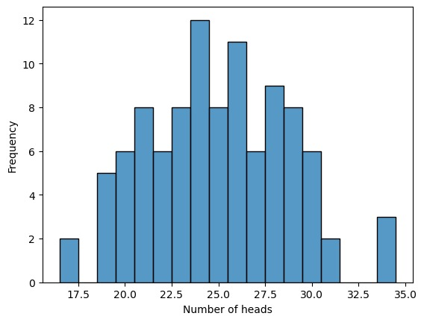
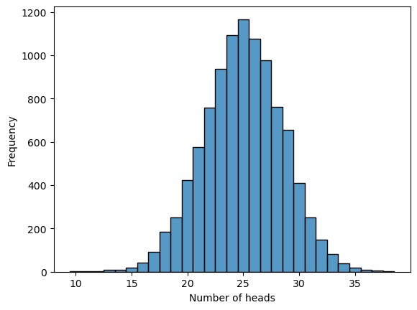
A Simpler Model:
-The Coin Flip

Slide 10
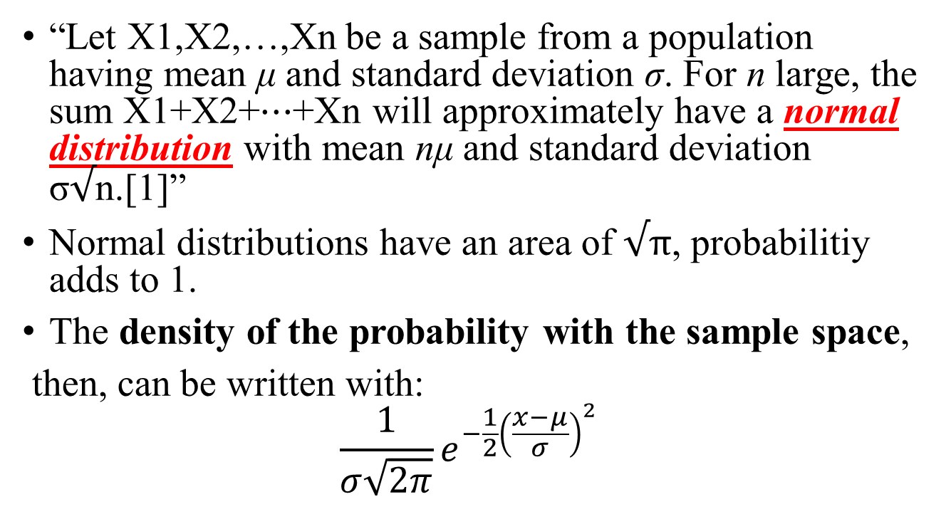
Central Limit Theorem
“Let X1,X2,…,Xn be a sample from a population having mean μ and standard deviation σ. For n large, the sum X1+X2+⋯+Xn will approximately have a normal distribution with mean nμ and standard deviation σ$√$n.[1]”
Normal distributions have an area of $√π$, probabilitiy adds to 1.
The density of the probability with the sample space,
then, can be written with:
$$\frac{1}{σ\sqrt{2π}}e^{−\frac{1}{2}{\left(\frac{x−μ}{σ}\right)}^{2} }$$
Source, Galton Board: https://tinyurl.com/yeyrnhjc

Slide 11
Probability Densities
The central limit theorem gives us a model for probabilities.
Let us make the variable continuous!
That gives us a problem : no sample spaces.
So, we define a function for probability density.

Slide 12
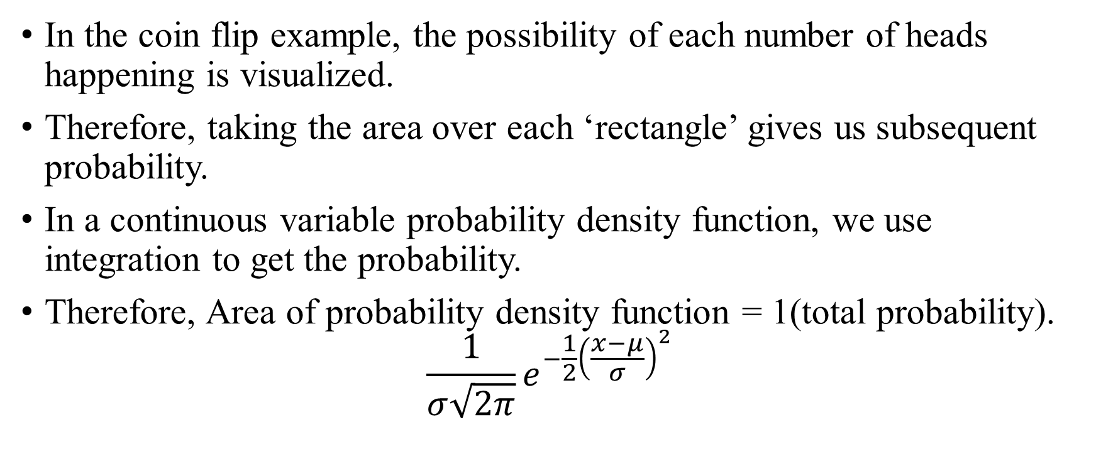
Probability density function
In the coin flip example, the possibility of each number of heads happening is visualized.
Therefore, taking the area over each ‘rectangle’ gives us subsequent probability.
In a continuous variable probability density function, we use integration to get the probability.
Therefore, Area of probability density function = 1(total probability). $\frac{1}{σ\sqrt{2π}}e^{−\frac{1}{2}{\left(\frac{x−μ}{σ}\right)}^{2} }$

Slide 13

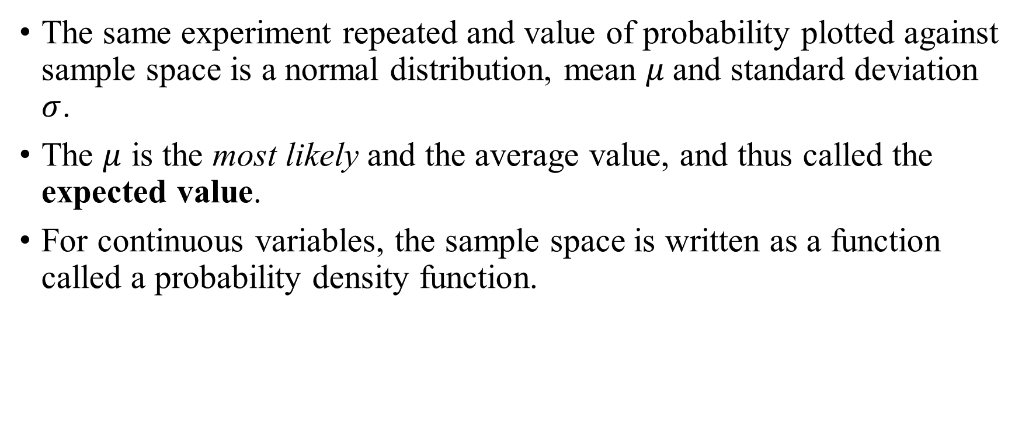
A Quick Review:
The same experiment repeated and value of probability plotted against sample space is a normal distribution, mean $μ$and standard deviation $σ$.
The $μ$ is the most likely and the average value, and thus called the expected value.
For continuous variables, the sample space is written as a function called a probability density function.
$$\frac{1}{σ\sqrt{2π}}e^{−\frac{1}{2}{\left(\frac{x−μ}{σ}\right)}^{2} }$$

Slide 14
Attempt to Arrive at a Rigorous Approach

Slide 15

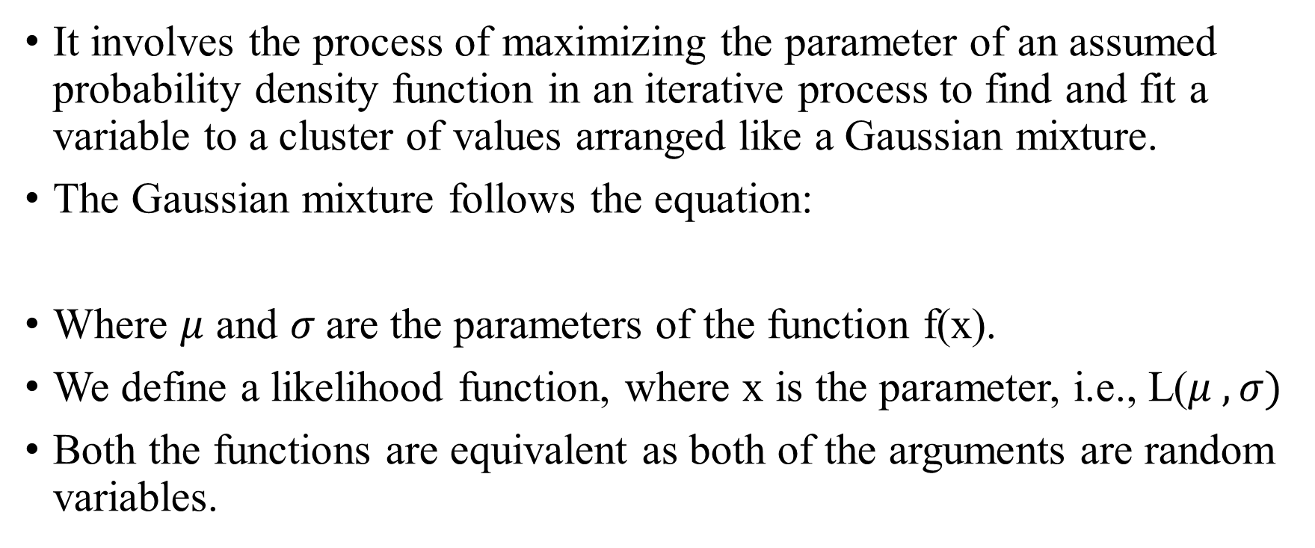
Expectation Maximization
It involves the process of maximizing the parameter of an assumed probability density function in an iterative process to find and fit a variable to a cluster of values arranged like a Gaussian mixture.
The Gaussian mixture follows the equation:
Where $μ$ and $σ$are the parameters of the function f(x).
We define a likelihood function, where x is the parameter, i.e., L($μ ,σ)$
Both the functions are equivalent as both of the arguments are random variables.
$$\frac{1}{σ\sqrt{2π}}e^{−\frac{1}{2}{\left(\frac{x−μ}{σ}\right)}^{2} }$$

Slide 16
Expectation Maximization(contd…)
If we take the log of the likelihood function, we get the function as a polynomial, letting us study the change much easier.
The First Iteration: Assume parameters and create a likelihood function.
Maximize the argument of the function and get the new parameters.
Repeat till the parameters don’t change.

Slide 17
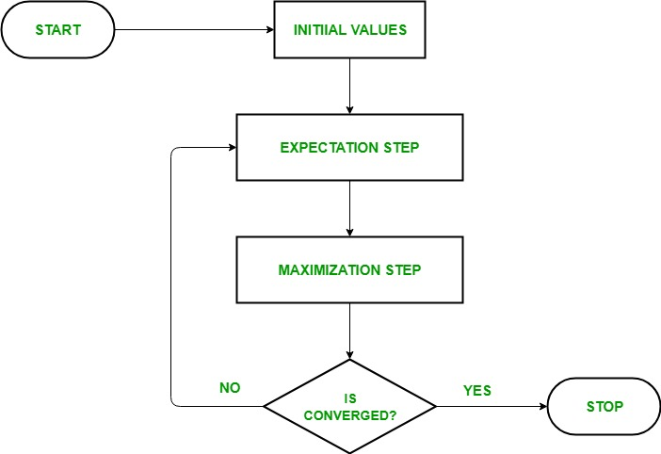
Review of the process
Source : https://tinyurl.com/bdedvhea

Slide 18
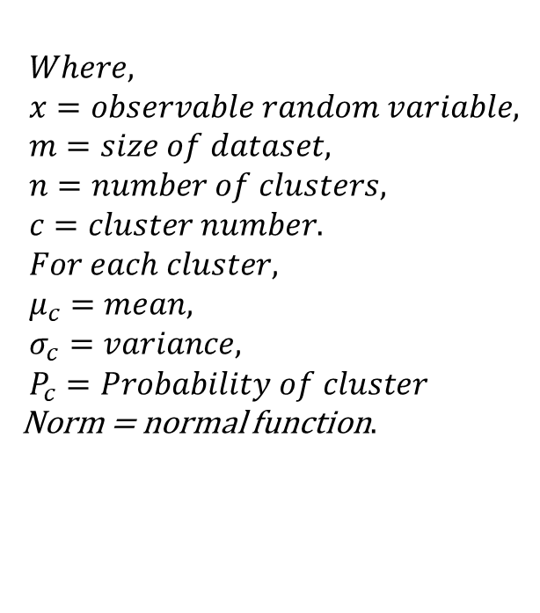

The General Process - Definitions
The probability density function is given by:
$P\left(x_{i}\right)= \sum_{c=1}^{n}{P_{c}.Norm(x_{i},μ_{c},σ_{c})}$
$$Where, \\ x=observable random variable, \\ m=size of dataset, \\ n=number of clusters, \\ c=cluster number. \\ For each cluster, \\ μ_{c}=mean, \\ σ_{c}=variance, \\ P_{c}=Probability of cluster$$ Norm = normal function$.$

Slide 19
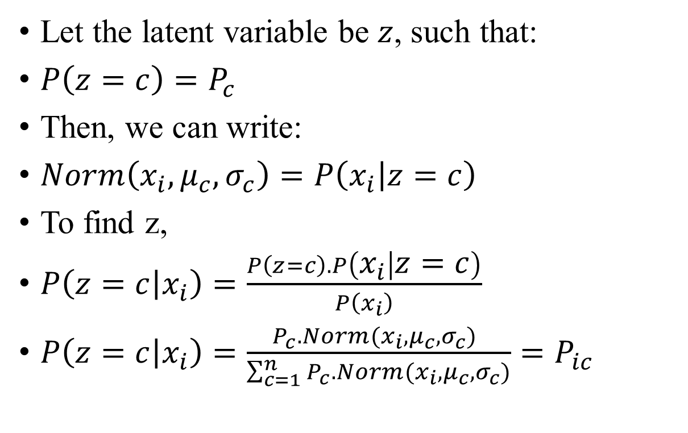
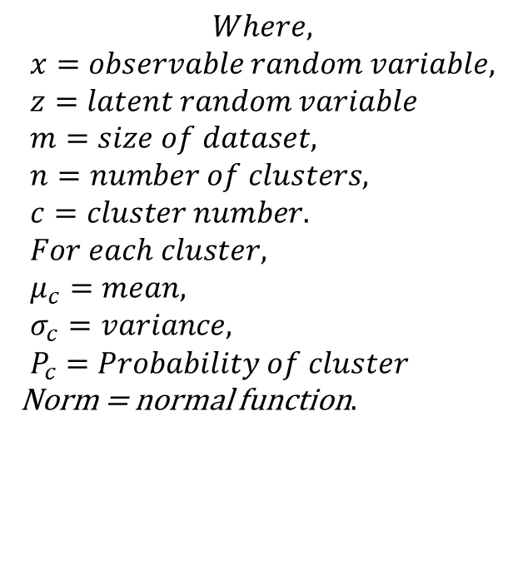
Step 1: Allocating Parameters
Let the latent variable be $z$, such that:
$P\left(z=c\right)=P_{c}$
Then, we can write:
$Norm\left(x_{i},μ_{c},σ_{c}\right)=P\left(x_{i} | z=c\right)$
To find z,
$P\left(z=c | x_{i}\right)=\frac{P\left(z=c\right).P\left(x_{i} | z=c\right)}{P\left(x_{i}\right)}$
$P\left(z=c | x_{i}\right)=\frac{P_{c}.Norm(x_{i},μ_{c},σ_{c}) }{\sum_{c=1}^{n}{P_{c}.Norm(x_{i},μ_{c},σ_{c})}}=P_{ic}$
$$Where,$$
$$x=observable random variable, \\ z=latent random variable \\ m=size of dataset, \\ n=number of clusters, \\ c=cluster number. \\ For each cluster, \\ μ_{c}=mean, \\ σ_{c}=variance, \\ P_{c}=Probability of cluster$$ Norm = normal function$.$

Slide 20
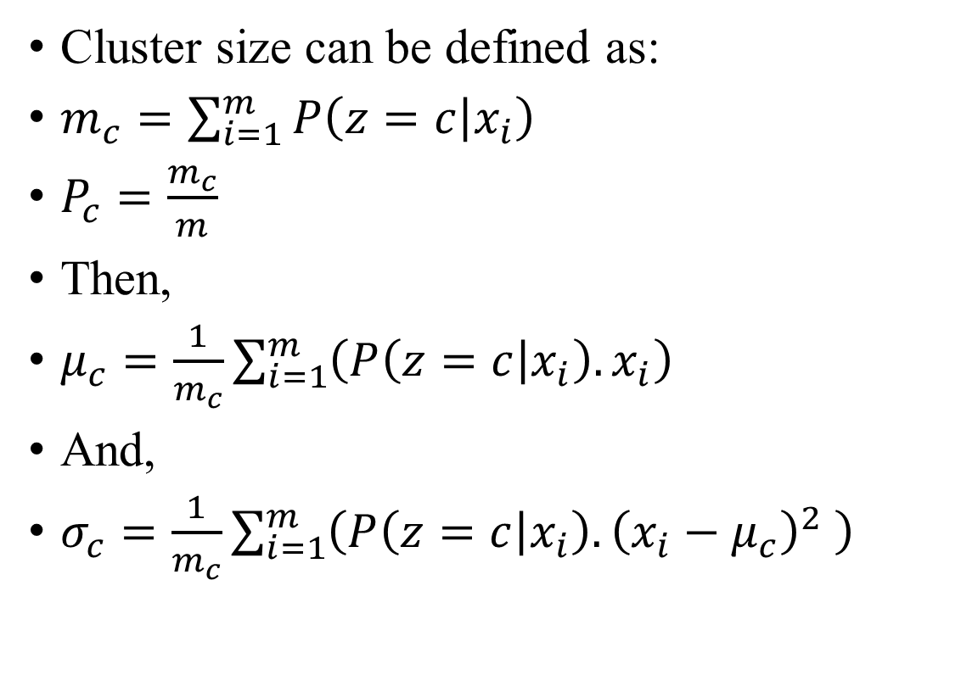
Step 2: Maximization of Parameters
Cluster size can be defined as:
$m_{c}=\sum_{i=1}^{m}{P\left(z=c | x_{i}\right) }$
$P_{c}=\frac{m_{c}}{m}$
Then,
$μ_{c}=\frac{1}{m_{c}}\sum_{i=1}^{m}{\left(P\left(z=c | x_{i}\right).x_{i}\right)}$
And,
$σ_{c}=\frac{1}{m_{c}}\sum_{i=1}^{m}{\left(P\left(z=c | x_{i}\right).{\left(x_{i}−μ_{c}\right)}^{2} \right)}$
$$Where,$$
$$x=observable random variable, \\ z=latent random variable \\ m=size of dataset, \\ n=number of clusters, \\ c=cluster number. \\ For each cluster, \\ μ_{c}=mean, \\ σ_{c}=variance, \\ P_{c}=Probability of cluster$$ Norm = normal function$.$

Slide 21
Advantages of EM
Unsupervised Learning
Handles Incomplete Data
Guaranteed Convergence
Commendable Flexibility
Soft Assignments – Probabilistic Information

Slide 22
Disadvantages of EM
Initialization Sensitivity
Slow Convergence makes it more expensive
Not robust to noisy data
Singularities and non-invertible covariances
Local Optima convergence
Computationally Expensive
Overfitting

Slide 23
Application of EM
Anomaly Detection:
EM can be employed in anomaly detection to model the distribution of normal data points. Any data point that deviates significantly from this model may be considered an anomaly.
Gaussian Mixture Model (GMM) in Clustering:
EM is commonly used for clustering data into multiple groups. A classic example is clustering customer purchasing behavior in marketing. You can use EM to identify different segments of customers based on their buying habits.
Image Compression:
EM can be applied to image compression. For instance, in the context of video coding, you can use EM to model the distribution of pixel intensities in an image, allowing for efficient compression based on the estimated model parameters.

Slide 24
Appendix
If the user needs more information, can refer to these youtube videos:
Expectation Maximization Algorithm | Intuition & General Derivation by Machine Learning & Simulation [2]
Expectation Maximization for the Gaussian Mixture Model | Full Derivation by Machine Learning & Simulation[3]
EM Algorithm for Latent Variable Models by Inside Bloomberg[4]
Lecture 14 - Expectation-Maximization Algorithms | Stanford CS229: Machine Learning (Autumn 2018) Stanford Online[5]
Sklearn Gaussian Mixture Models[6]
J. A. Bilmes and Others, ‘A gentle tutorial of the EM algorithm and its application to parameter estimation for Gaussian mixture and hidden Markov models’, 1998.[7]

Slide 25
References
[1] “Central limit theorem,” Central Limit Theorem - an overview | ScienceDirect Topics, https://www.sciencedirect.com/topics/mathematics/central-limit-theorem (accessed Nov. 3, 2023).
[2] Machine Learning & Simulation. Expectation Maximization Algorithm | Intuition & General Derivation. (Apr. 8, 2021). Accessed: Nov. 3, 2023. [Online Video]. Available: https://www.youtube.com/watch?v=MujtZ4A23t8&ab_channel=MachineLearning%26Simulation
[3] Machine Learning & Simulation. Expectation Maximization for the Gaussian Mixture Model | Full Derivation. (Apr. 9, 2021). Accessed: Nov. 3, 2023. [Online Video]. Available: https://www.youtube.com/watch?v=ZI98eg3CRls&ab_channel=MachineLearning%26Simulation
[4] Inside Bloomberg. 27. EM Algorithm for Latent Variable Models. (July 11, 2018). Accessed: Nov. 3, 2023. [Online Video]. Available: https://www.youtube.com/watch?v=lMShR1vjbUo&ab_channel=InsideBloomberg
[5]Stanford Online. Lecture 14 - Expectation-Maximization Algorithms | Stanford CS229: Machine Learning (Autumn 2018). (Apr. 17, 2020). Accessed: Nov. 3, 2023. [Online Video]. Available: https://www.youtube.com/watch?v=rVfZHWTwXSA
[6] “Gaussian mixture models”, [Online]. Available: https://scikit-learn.org/stable/modules/mixture.html. [Accessed: 3-Nov.-2023].
[7] J. A. Bilmes and Others, ‘A gentle tutorial of the EM algorithm and its application to parameter estimation for Gaussian mixture and hidden Markov models’, 1998. [Accessed: 3-Nov.-2023]

